Slide 1
Software Analysis
and Design

Slide 2
Key Definitions
A process model is a formal way of representing how a business operates
Data flow diagramming shows business processes and the data that flows between them
Logical process models describe processes without suggesting how they are conducted
Physical models include information about how the processes are implemented
5
6

Slide 3
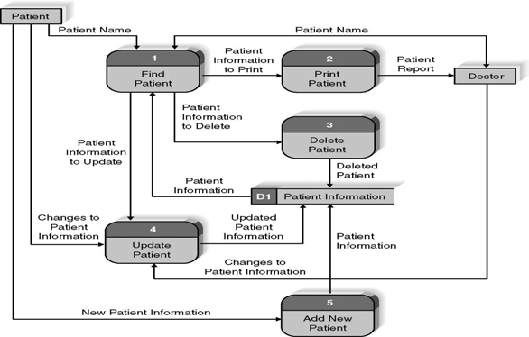
Reading a Data Flow Diagram (DFD)
7

Slide 4
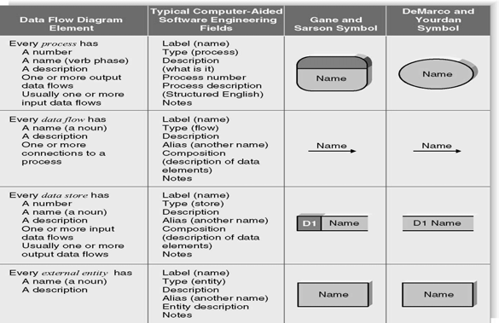
DFD Elements
8

Slide 5
Structured English
Common Statements | Example
Action Statement | Profits = Revenues - Expenses Generate Inventory - Report Add Product record to Product Data Store
If Statement | IF Customer Not in Customer Data Store THEN Add Customer record to Customer Data Store ELSE Add Current-Sale to Customer’s Total-Sales Update Customer record in Customer Data Store
For Statement | FOR all Customers in Customer Data Store Generate a new line in the Customer-Report Add Customer’s Total-Sales to Report-Total
Case Statement | CASE If Income < 10,000: Marginal-tax-rate = 10% If Income < 20,000: Marginal-tax-rate = 20% If Income < 30,000: Marginal-tax-rate = 31% If Income < 40,000: Marginal-tax-rate = 35% ELSE Marginal-tax-rate = 38% ENDCASE
9
10

Slide 6
Key Definition
Decomposition is the process of modeling the system and its components in increasing levels of detail.
Balancing involves insuring that information presented at one level of a DFD is accurately represented in the next level DFD.
Context Diagram
Shows the context into which the business process fits
Shows the overall business process as just one
process
Shows all the outside entities that receive information from or contribute information to the system
11
10

Slide 7
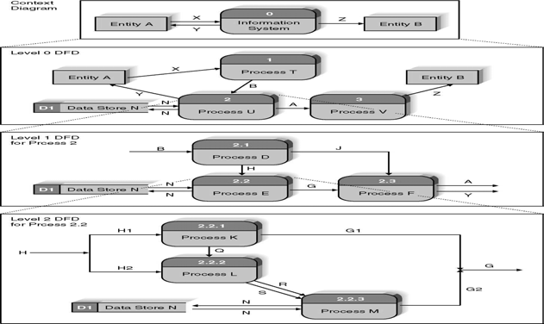
Relationship Among DFD levels
12

Slide 8
Level 0 Diagram
Shows all the processes that comprise the overall system
Shows how information moves from and to each process
Adds data stores
Level 1 Diagrams
Shows all the processes that comprise a single process on the level 0 diagram
Shows how information moves from and to each of these processes
Shows in more detail the content of higher level process
Level 1 diagrams may not be needed for all level 0 processes
14

Slide 9
Level 2 Diagrams
Shows all processes that comprise a single process on the level 1 diagram
Shows how information moves from and to each of these processes
Level 2 diagrams may not be needed for all level 1 processes
Correctly numbering each process helps the user understand where the process fits into the overall system
15
Data Flow Splits and Joins
A data flow split shows where a flow is broken into its component parts for use in separate processes
Data flow splits need not be mutually exclusive nor use all the data from the parent flow
As we move to lower levels we become more precise about the data flows
A data flow join shows where components are merged to describe a more comprehensive flow
16

Slide 10
Alternative Data Flows
Where a process can produce different data given different conditions
We show both data flows and use the process description to explain why they are alternatives
Tip -- alternative data flows often accompany processes with IF statements
Elements of a Use Case
Trigger -- event that causes the scenario to begin
External trigger
Temporal trigger
All possible inputs and outputs
Individual steps
Show sequential order
Show conditional steps
17
18

Slide 11
DFD and Use Cases
The Data Flow Diagram (DFD) is an essential tool for creating formal descriptions of business processes and data flows.
Use cases record the input, transformation, and output of business processes.
Eliciting scenario descriptions and modelling business processes are critically important skills for the systems analyst to master.
Process Modeling and DFDs
Define process modeling
Discuss the purpose of data flow diagrams
Discuss the components of a DFD
Discuss the rules for constructing DFD
Discuss functional decomposition
Create DFD
20

Slide 12
Key Ideas
Process modeling can be used with manual or computerized systems
Always design processes from the viewpoint of the organization running the system
Data flow diagrams are a graphical representation of business processes in an information system
Focus of data flow diagrams is on processes and activities, not data (despite the name)
21
Process Modeling
Describes business processes or the activities that people do
Used to document and organize information gathered during systems analysis
Focus on processes or activities
Start with text description of processes then create DFDs
22

Slide 13
Data Flow Diagrams
Show the flow of data and logic within a system
Model:
sources and destinations of data
data inputs and outputs
actions that transform inputs into outputs
data maintained by an information system
DFDs
Primary modeling technique used in traditional systems development
Start by creating a context DFD
shows boundaries or scope of the system
this is the highest level DFD
have a single process representing the entire information system and list external entities and data flows
24

Slide 14
Types of DFDs
Logical DFD –
models what the system does
Physical DFD-
models how it will be done
Possibilities
Current logical
Current physical
New logical
New physical
25
26

Slide 15
Elements of a DFD
Processes
Data Flows
Data stores
External entities
Process
Any activity that transforms data
Components:
process identification #
process description label
Each process performs only one activity
27
28

Slide 16
Data flow
Traces flow of information throughout the system
It is data in motion
Data store
Also known as data repository
Is where data is temporarily or permanently stored or held
External entity
External Entity - something or someone that provides data to the system or receives output from the system
does not perform any system processes
name of entity goes inside the symbol
30

Slide 17
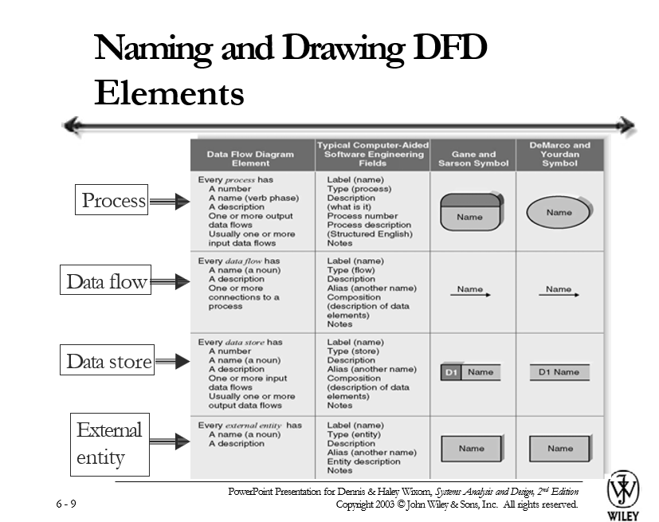

Slide 18
Rules
Sequence of processes must move from left to right, top to bottom
Every data flow must begin or end at a process
Avoid black holes
Avoid magic process
Business Processes and DFDs
Business processes cannot be depicted with a single DFD.
Decomposition is used to depict business processes with a hierarchy of diagrams
– Parent and child diagrams
Balancing is used to ensure accuracy of diagrams at all levels in the hierarchy
33
34

Slide 19
Steps in constructing DFDs
Create a context DFD
Create DFD fragments
Create level 0 diagram
Create level 1,…,level n diagrams
Validate diagrams created
Functional decomposition
Once a context DFD is created,
then create Level 0 DFD
Processes from Level 0 DFD are further decomposed
until a sufficient level of detail is reached
Do it until no sub process can logically be broken down any further
Lowest level DFD is called a primitive DFD
36

Slide 20
Creating a context diagram
Provides a summary of the overall system
A single process represents the entire information system
List external entities and data flows
Number for process is 0
Creating a level 0 diagram
Shows major processes that are a part of the overall system
Shows how the major processes are interrelated by data flows
Shows external entities and the major processes with which they interact
Adds data stores
38

Slide 21
Creating level 1 diagrams
Generally, one level 1 diagram is created for every major process on the level 0 diagram
Shows all the internal processes that comprise a single process on the level 0 diagram
Shows how information moves from and to each of these processes
If a parent process is decomposed into, for example, three child processes, these three child processes wholly and completely make up the parent process
Validate DFDs
Look for:
Syntax errors
Semantic errors
Use:
User walkthroughs
Role-play
Examine lowest level DFD to ensure consistent decomposition
Examine names to ensure consistent use of terms
40

Slide 22
Describing complex processes
Techniques used include:
Structured English
Decision Trees
Decision Tables
Use Cases & DFDs
Major use cases become high level processes on Level 0 DFD
Inputs and outputs become data flows
Number process same as use case number
Change process name into verb phrase
Combine DFD fragments into one diagram
Each step becomes a process for the level 1 DFD
41
42

Slide 23
Key Definitions
A process model is a formal way of representing how a business operates
Data flow diagramming shows business processes and the data that flows between them
Key Definitions
Logical process models describe processes without suggesting how they are conducted
Physical models include information about how the processes are implemented
43
44

Slide 24
Creating Data Flow Diagrams: Integrating Scenario Descriptions
DFDs generally integrate scenario descriptions
Names of use cases become processes
Names of inputs and outputs become data flows
Combining “small” data inputs and outputs into a single flow
Steps in Building DFDs
Build the context diagram
Create DFD fragments for each scenario
Organize DFD fragments into level 0
Decompose level 0 DFDs as needed
Validate DFDs with user
46

